Slide 1


Estimating the Effective Population Size of Delta Smelt
Shannon Joslin
Ismail Saglam, Michael R. Miller, Alisha Goodbla and Amanda Finger
University of California, Davis
@IntrprtngGnmcs
@shannonekj

Slide 2

A brief history…
Adults 5-7cm
Annual species
Smell like cucumbers
Endemic to the San Francisco Estuary
Population has been declining since 1970s
Federally listed in 1993
Captive population in Discovery Bay
Effective population size estimated since 2003

Slide 3
What is effective population size?
The size of an ideal population which genetic drift occurs at the same rate as that in an actual population.
What is drift?
Random variation in the relative frequency of alleles in a population
Why estimate the effective population size?
Can be used to monitor the genetic diversity of wild population of Delta Smelt

Slide 4
What is Genetic Diversity?
The amount of genetic variation within and among individuals of the same species.
Depends on:
number of alleles
frequency of alleles
PC1
PC2
Novembre et al. Nature 2008

Slide 5
Importance of Genetic Diversity
It is the raw component of natural selection
Larger pool of variation may allow adaptation to increasingly variable climates
Can be incorporated into models of adaptive potential
Bay et al. Science 2018

Slide 6
What affects genetic diversity?
Boons
Mutation
Gene flow
Busts
Nonrandom mating
Skewed sex ratios
Inbreeding
Small populations
Stochastic processes act to decrease alleles in populations.
N=500
N=50
N=10
Genetic variation
Generations
Schou & Bechsgaard 2017

Slide 7
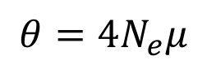
Measuring Genetic Diversity
$$θ=4N_{e}μ$$
Watterson’s Theta
Number of segregating sites
Theta Pi
Pairwise nucleotide diversity
vs
Segregating sites
Sample size

Slide 8


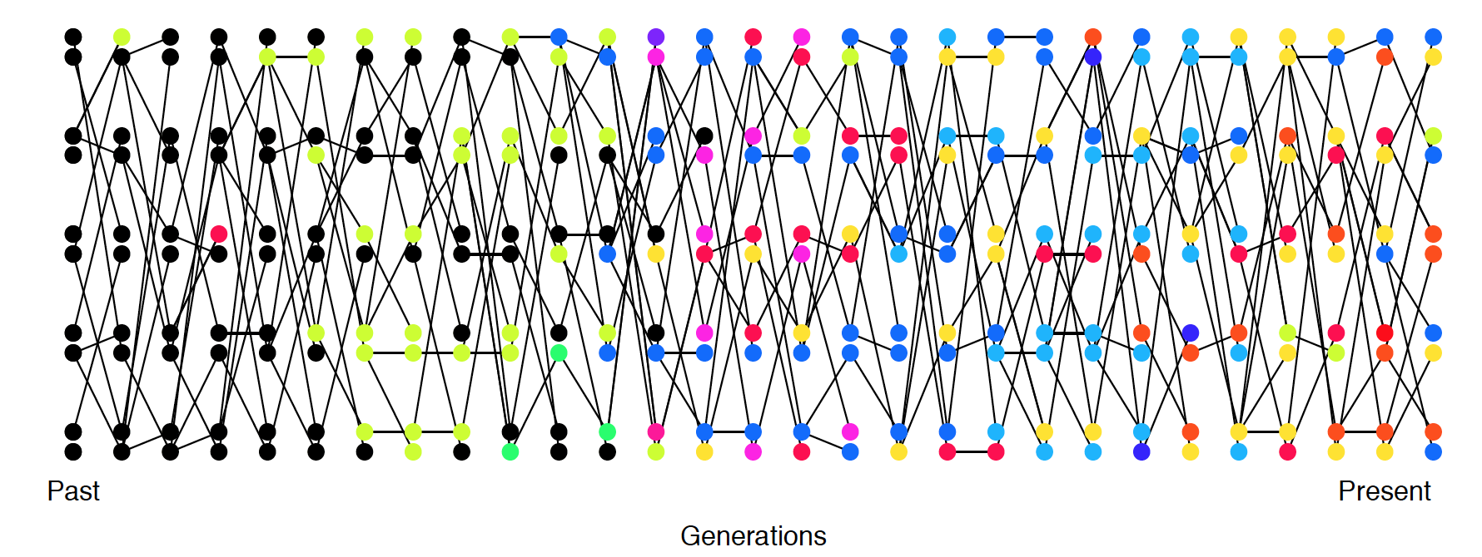
Effective Population Size (Ne)
mutation!
gene
flow!
Past
Present
Mutation and gene flow increase genetic diversity.
Figure: Coop 2017

Slide 9
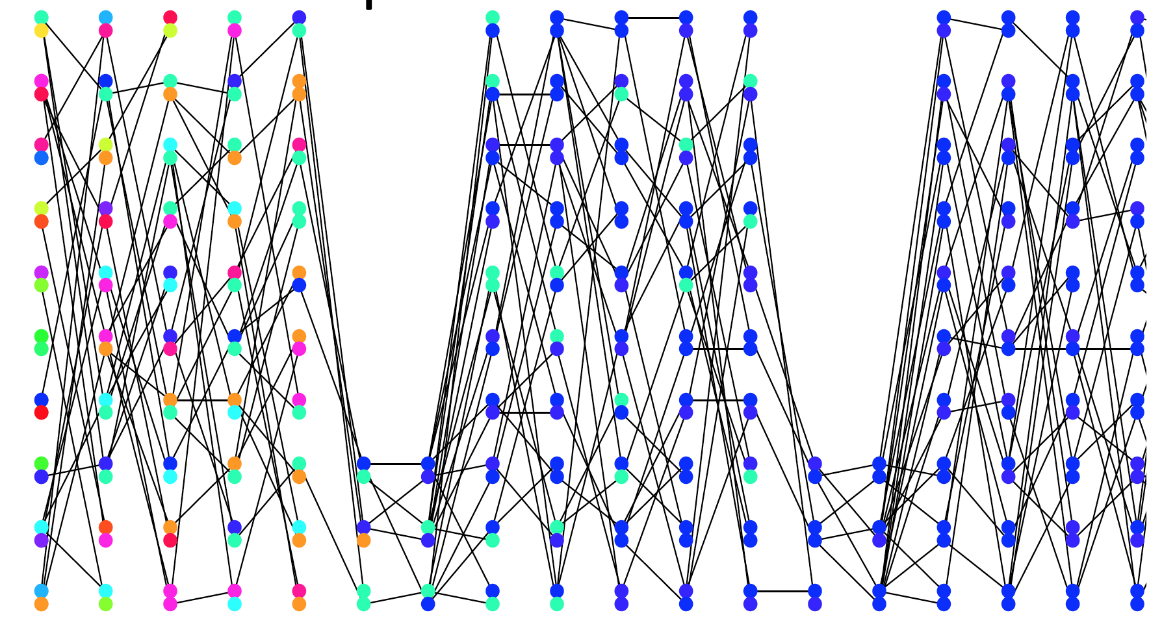
Demographic processes can act to decrease diversity
Past
Present
Figure: Coop 2017

Slide 10
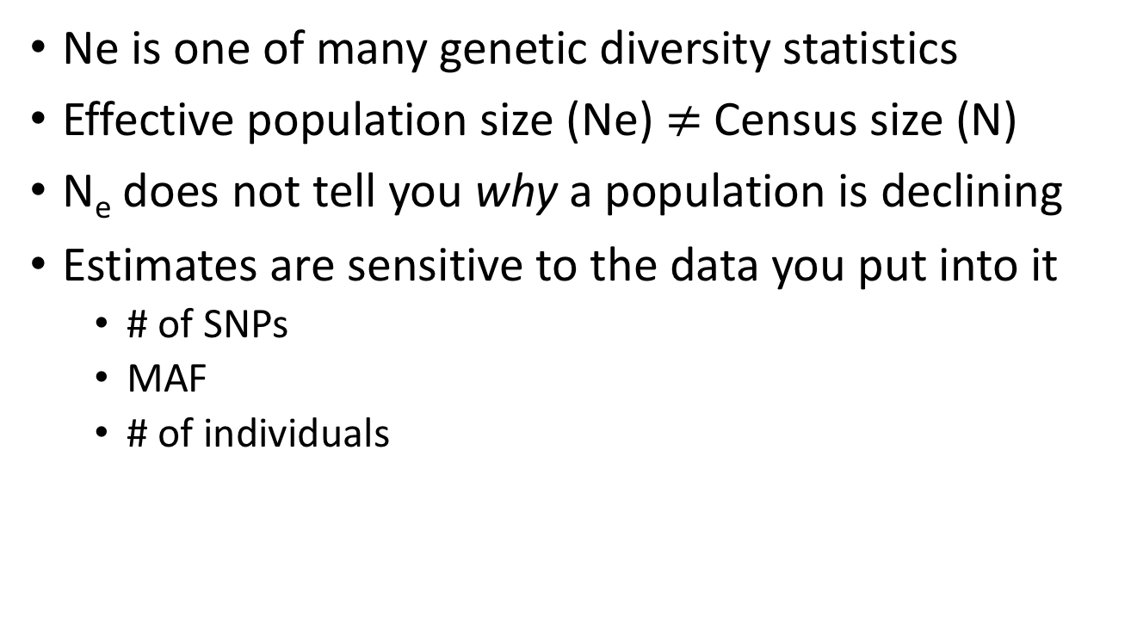
Limitations of Effective Population Size
Ne is one of many genetic diversity statistics
Effective population size (Ne) $≠$ Census size (N)
N_{e} does not tell you why a population is declining
Estimates are sensitive to the data you put into it
# of SNPs
MAF
# of individuals

Slide 11
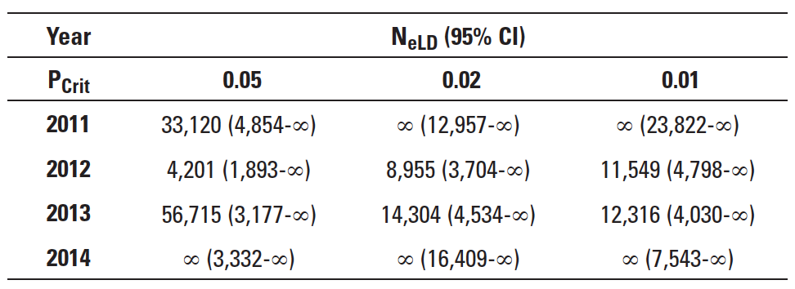
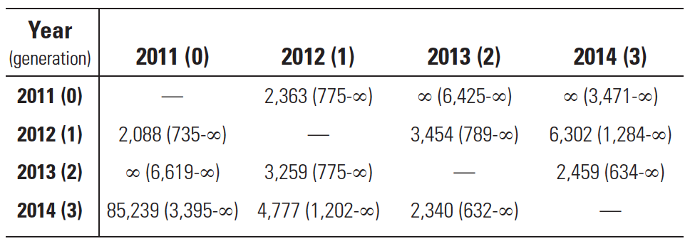
Previous estimates Ne
12-15 microsatellites | 4-8 generations
N_{eV}
Fisch et al. Conserv. Gen. 2011
Finger et al. San Fran. Est. Wat. Sci. 2017

Slide 12



Harnessing the power of NGS
Microsatellite (previous work) – samples 12-15 sites throughout the genome
marker
linkage group
Linkage
Group 1
Linkage
Group 2
Restriction site associated sequencing (current work) – samples thousands of loci genome-wide

Slide 13
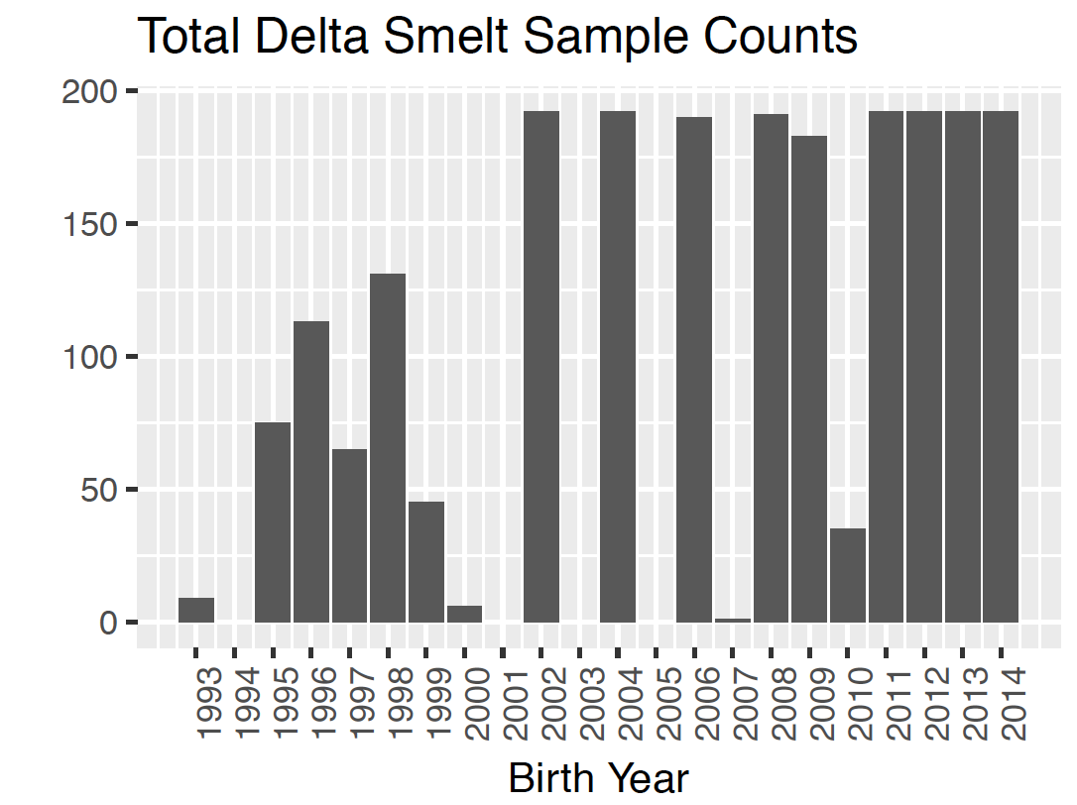

Increase Sample Size
Birth Year | Samples | Birth Year | Samples
1993 | 9 | 2005 | 0
1994 | 0 | 2006 | 190
1995 | 75 | 2007 | 1
1996 | 113 | 2008 | 191
1997 | 65 | 2009 | 183
1998 | 131 | 2010 | 35
1999 | 45 | 2011 | 192
2000 | 6 | 2012 | 192
2001 | 0 | 2013 | 192
2002 | 192 | 2014 | 192
2003 | 0 | 2015 | 108
2004 | 192 | 2016 | 84
2015
2016

Slide 14
Genomic Variation is Decreasing

Slide 15
Long term Ne is decreasing
Effective Population Size of Delta Smelt 1995-2016

Slide 16
The Future
Investigate outlying years
Contemporary Ne
Sequence Delta Smelt genome to more accurately monitor genetic diversity
Incorporate into models to assist management
Photo: CA Dept. Water Resources

Slide 17


Thank you!
Contact: Shannon Joslin
sejoslin@ucdavis.edu
@IntrprtngGnmcs
Dept. Water Res.
Genomic Variation Lab
Miller Lab
Mandi Finger
Alisha Goodbla
Alyssa Benjamin
Ismail Saglam
Mike Miller
Andrea Schreier
Melinda Baerwald
Ted Sommers

